Slide 1
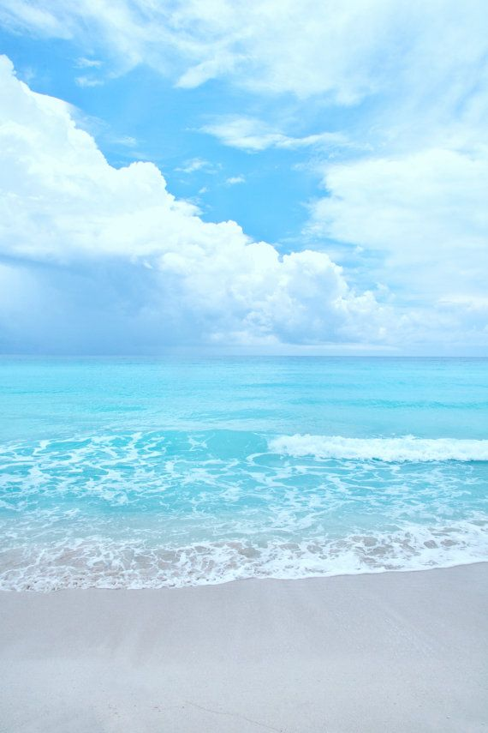

SCHOOL OF ELECTRICAL AND ELECTRONICS ENGINEERING
A MINI PROJECT ON:-
Water surface cleaning RC boat
Submitted by:
TEAM ATH CRUISER :-
1}K.YASHWANTH.REDDY
2}AKASH.MANGOND
3}HRISHABH.RATHORE
4}MUKESH.M
5}NAMAN.H.A
Under the guidance of:-
Asst Prof:- 1}ADITYA SIR
2} PAVAN SIR
Rukmini Knowledge Park, Kattigenahalli, Yelahanka, Bengaluru-560064
www.reva.edu.in

Slide 2
DECLARATION
We are TEAM ATH CRUISER students of B. Tech, belongs to School of Electrical and Electronics Engineering, REVA University, declare that this Project Report / Dissertation entitled “RC WATER SURFACE CLEANING BOAT” is the result the of mini project / dissertation work done by us at School of EEE REVA University.
We are submitting this Mini Project Report / Dissertation in partial fulfillment of the requirements for the award of the degree of Bachelor in Electrical and Electronics Engineering by the REVA University, Bengaluru during the academic year 2022-23
I declare that this project report has been tested for plagiarism and has passed the plagiarism test with the similarity score less than 25% and it satisfies the academic requirements in respect of Project work prescribed for the said Degree.
We further declare that this project / dissertation report or any part of it has not been submitted for award of any other Degree of this University or any other University/ Institution.
(Signature of the Students)
Signed by me on 10th July 2022.
Certified that this project work submitted by TEAM ATH CRUISER has been carried out under my / our guidance and the declaration made by the candidate is true to the best of my knowledge.
Signature of Guide Signature of Director
Date: 10th July 2022 Date: 10th July 2022.
Official Seal of the School

Slide 3
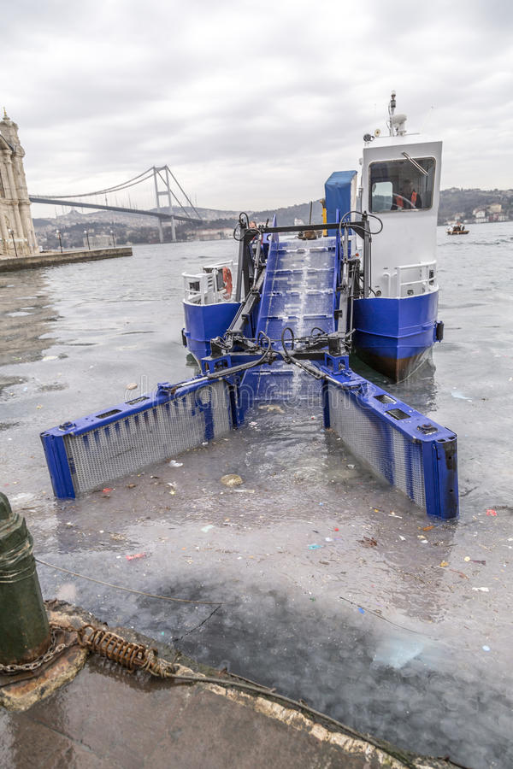
INTRODUCTION
We know that many industries are getting established whose wastes are disposed into water sources which lead to water pollution. Many steps have been taken to reduce emission of toxics present in disposed waste.
To control water pollution . We feel uncomfortable when we see the water source getting accumulated with solid substance which blocks the flow of water which further arises the problem of water scarcity. Increasing water pollution is a dangerous sign to all organisms living in water(aquatic life)
The solids substance such as plastics, thermocol and other harmful substances which contains harmful toxics like polyvinyl chloride which in commonly known as PVC, most toxic plastic for health and environment. Moreover untreated waste in rivers, seas and lakes result in the accumulation of toxic substances in food chain through the various organisms that feed on it which in return and consumed by humans.
This project is an attempt to solve the problem in food chain through the various organisms that feed on it which in return are consumed by humans.

Slide 4

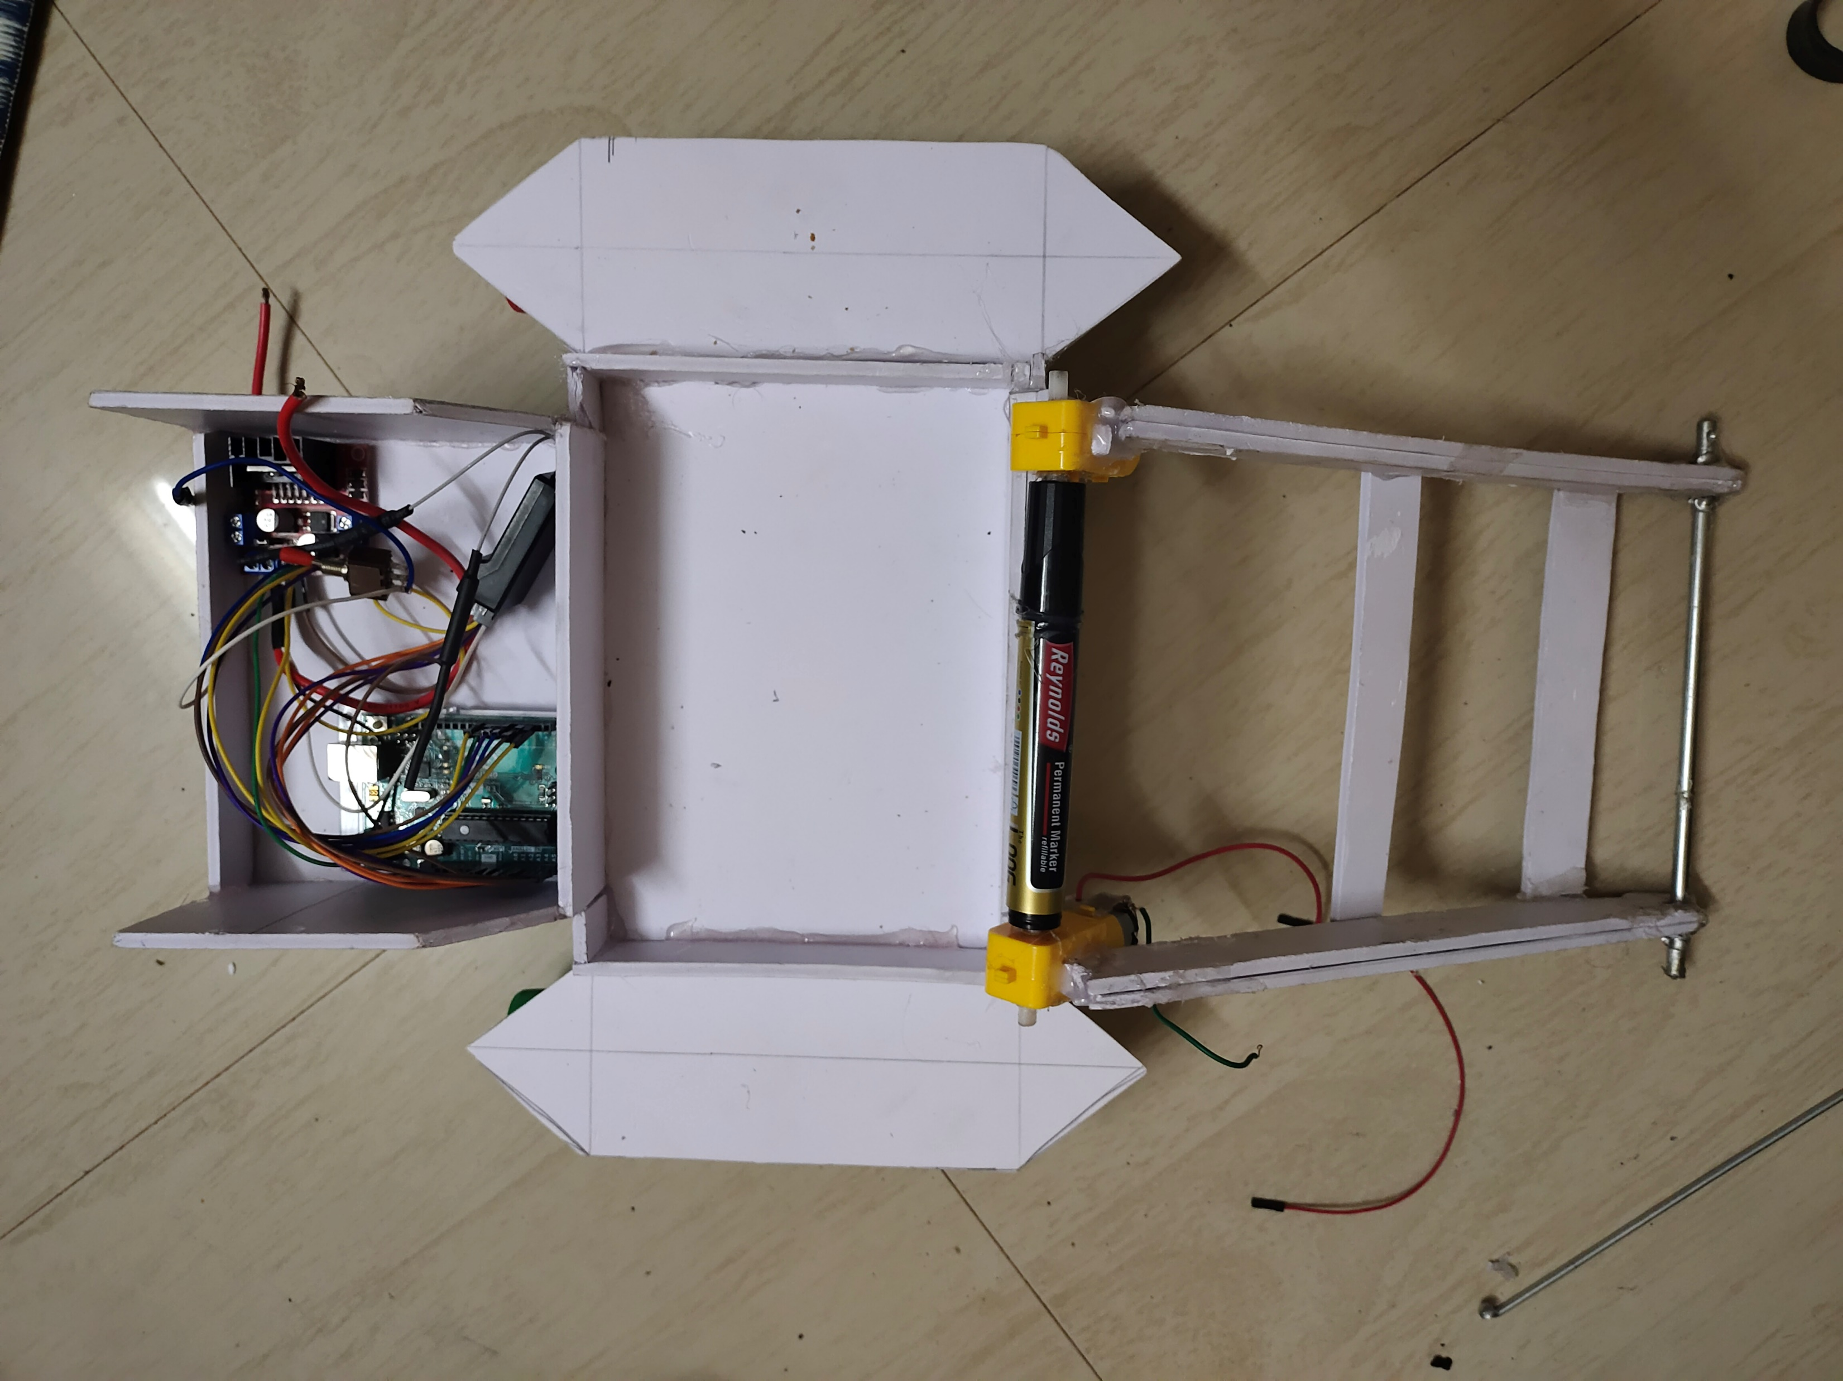
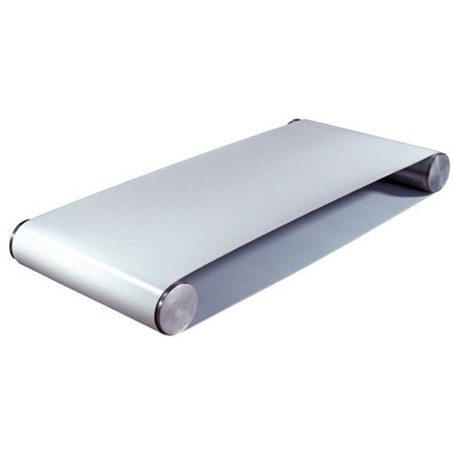
SCIENTIFIC PRINCIPAL INVOLVED
The Entire body consists of two parts
Conveyor Belt: when the substance comes in the contact with its which is carried through a loop of carrying medium both are of one of the pulleys are powered , moving the belt and the material on the belt forward
2) The carrying body: The cylinder which if fixed to the
motor connected through Arduino board, starts
rotating so that the entire cylinder starts moving as a
normal automobile does

Slide 5
MATERIALS REQUIRED
1} Arduino uno .
2}FS-IA 6B ,
3}Lipo Battery (lithium polymer battery)
4}Jumper wires,
5}Synthetic Material(for conveyor belt)
6}Pen / Marker
7}Cycle spokes
8}Sun board sheet
9}Empty bottle,
10}DC gear motors (1000rpm,100rpm)
11}Motor driver L298

Slide 6
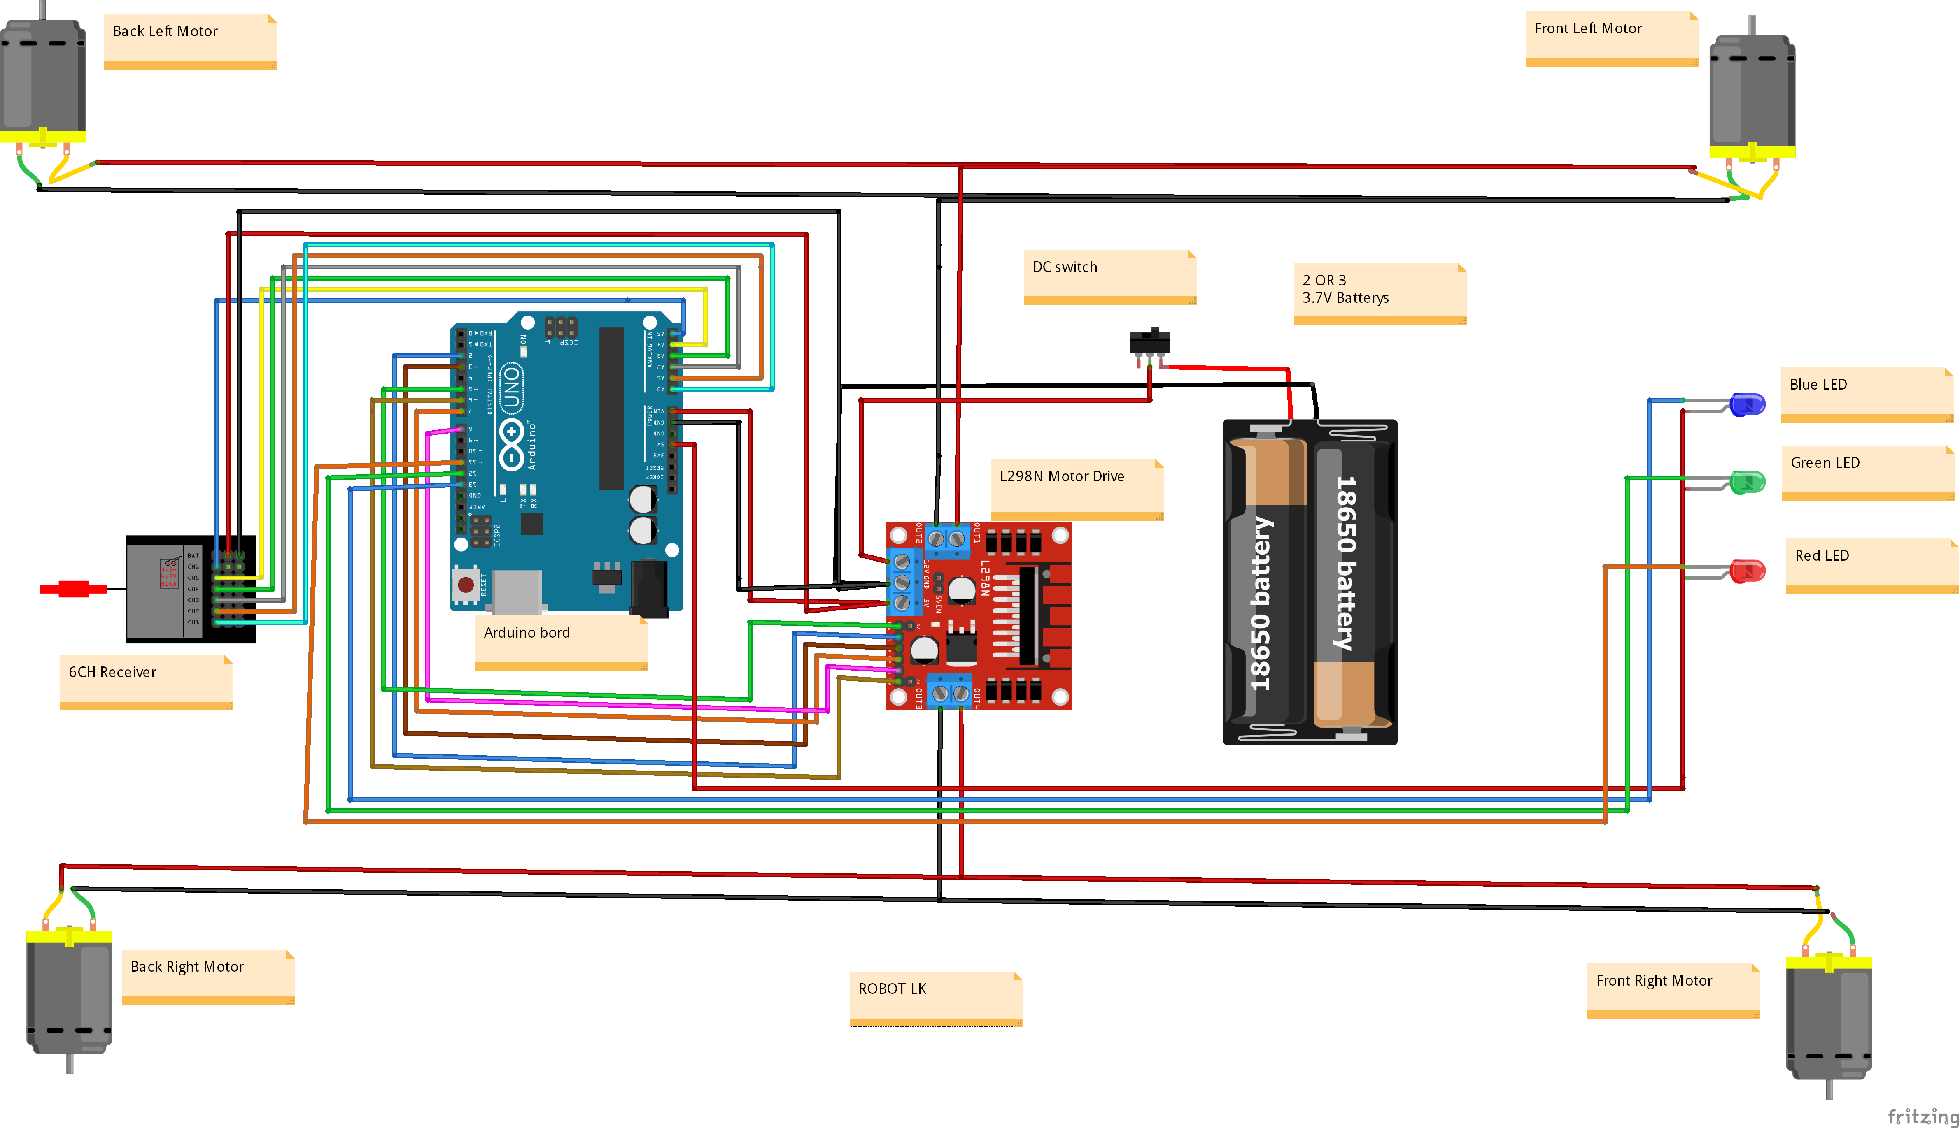
CIRCUIT DIAGRAM

Slide 7

Construction AND WORKING
In this project are the main body is connected to conveyor belt which runs o a 100 rpm motor powered through a 9v DC battery. The main boat structure runs on a 1000 rpm brushed DC motor which is connected through Arduino uno and L298N motor driver, for making it Remote controlled we have used Fs – IA6B receiver and transmitter powered through a 12v Lipo battery(lithium polymer battery).The boat moves in the direction chosen by the user, the conveyor belt rotates in anti clockwise direction for the intake of the plastic bodies present in the water body. In this project are the main body is connected to conveyor belt which runs o a 100 rpm motor powered through a 9v DC battery. The main boat structure runs on a 1000 rpm brushed DC motor which is connected through Arduino uno and L298N motor driver, for making it Remote controlled we have used Fs- IA6B receiver and transmitter powered through a 12v Lipo battery(lithium polymer battery).The boat moves in the direction chosen by the user, the conveyor belt rotates in anti clockwise direction for the intake of the plastic bodies present in the water body.

Slide 8
CODE:-
int in1 = 2;
int in2 = 3;
int enable1 = 5; // pin with ~ symbol
int channel_2 = 6; // pin with ~ symbol
void setup()
{ pinMode(channel_2, INPUT);
pinMode(in1, OUTPUT);
pinMode(in2, OUTPUT);
pinMode(enable1, OUTPUT);
Serial.begin(9600);
}void loop()
{
int pwm = 0;
int value = pulseIn(channel_2, HIGH, 25000); if(value==0)
{
digitalWrite(in1, LOW);
digitalWrite(in2, LOW);
analogWrite(enable1, 0);
}
else if(value > 1530)
{
pwm = map(value, 1530, 2000, 0, 255); digitalWrite(in1, LOW);
digitalWrite(in2, HIGH);
analogWrite(enable1, pwm);
}
else if(value < 1460)
{
pwm = map(value, 1460, 1000, 0, 255);
digitalWrite(in1, HIGH);
digitalWrite(in2, LOW);
analogWrite(enable1, pwm);
}
else
{
digitalWrite(in1, LOW);
digitalWrite(in2, LOW);
analogWrite(enable1, 0);
}
delay(10);
}

Slide 9
Advantages:
It is of portable and efficient.
It is eco friendly.
Manual labour can be decreased
This project is very useful for small as well as big lakes, rivers where garbage is present in large amount..
Result:-
It ensures lowering of the pollution of the water bodies due to industrial waste and agriculture waste . So that we can save aquatic animals and save our mother earth from this pollution
FUTURE SCOPE :-
The machine can be designed for deep cleaning. Capacity of the machine can be increased for cleaning big rivers and lakes.

Slide 10
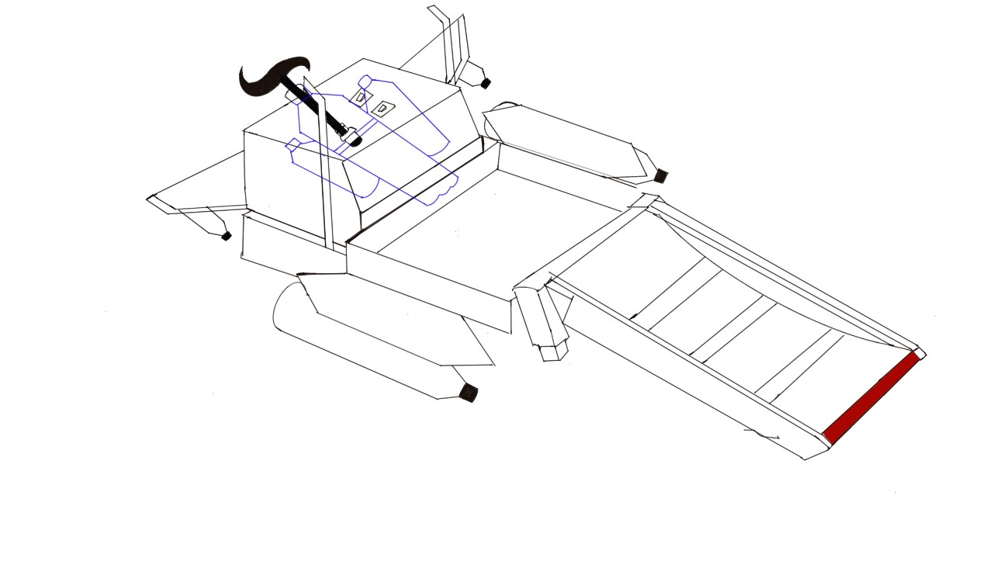
CONCLUSIONS :-
This project “ WATER SURFACE CLEANING RC
BOAT “ has designed which is very much
economical, easy to operate and helpful for water
cleaning and it can be modified with more cleaning
capacity and efficiency.
PHOTOS:-

Slide 11
